Slide 1
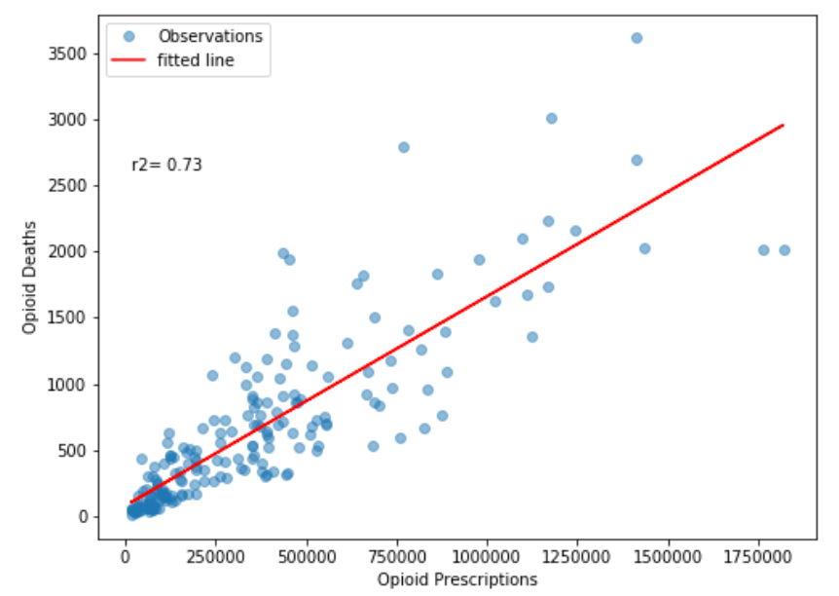


Slide 2
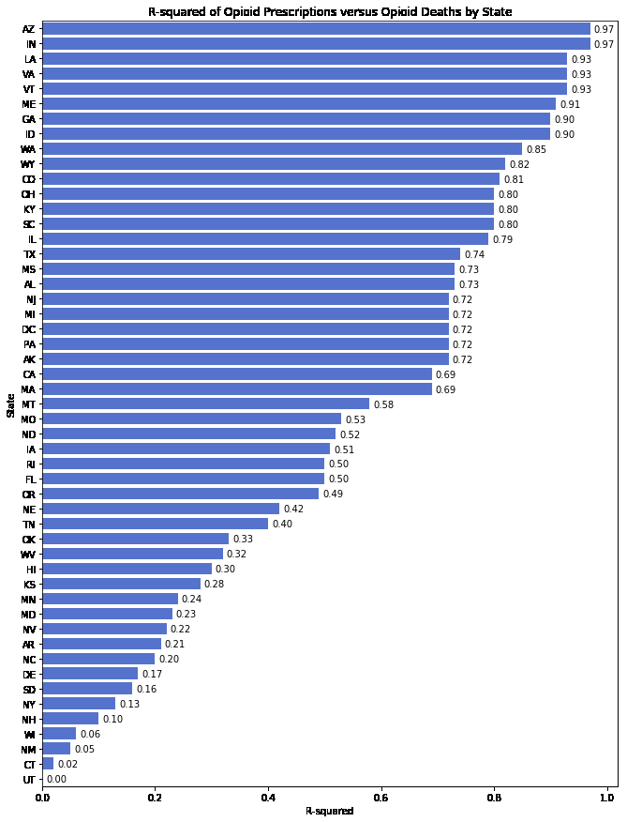

Slide 3
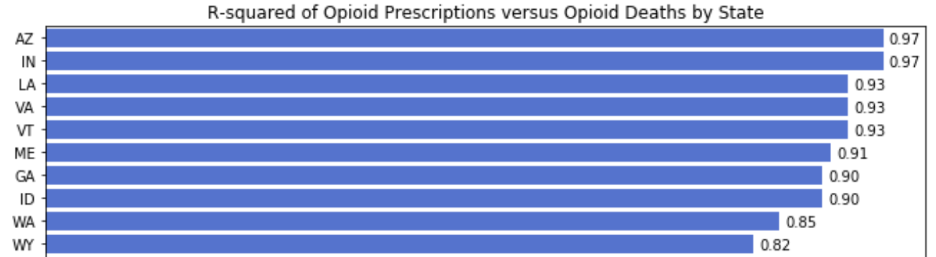
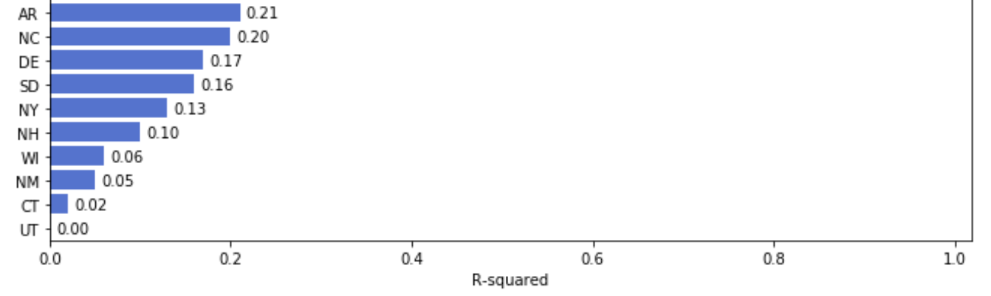

Slide 4
Conclusion
Opioids are a class of drugs that include the illegal drug heroin, synthetic opioids such as fentanyl, and pain relievers available legally by prescription.
Opioid overdose deaths increased sharply in 2013 and continue to grow.
The U.S. opioid epidemic claimed over 42,000 lives in 2016.
Opioid abuse has become a significant public health risk.
As of 2016, opioids account for nearly two-thirds of all overdose deaths.
Fentanyl has overtaken other prescription opioids as a leading cause of opioid overdose death.
Fentanyl is a highly addictive pain medication commonly used to treat pain in cancer patients undergoing chemotherapy. It can cause respiratory distress and death when combined with other substances especially alcohol.
There are large variations in state and regional opioid overdose data.
Prescription opioids are correlated to opioid deaths.
Some evidence that doctors prescribing opioids may contribute to opioid abuse.
Correlation vs Causation, more research is needed.

